Slide 1
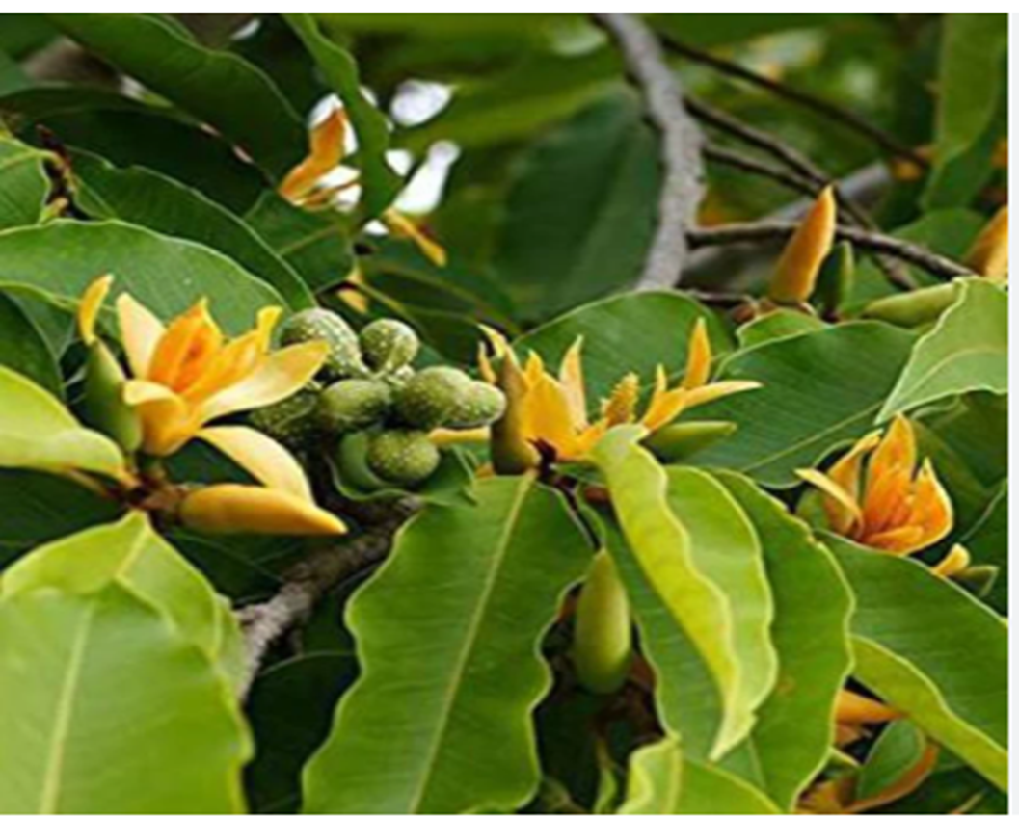
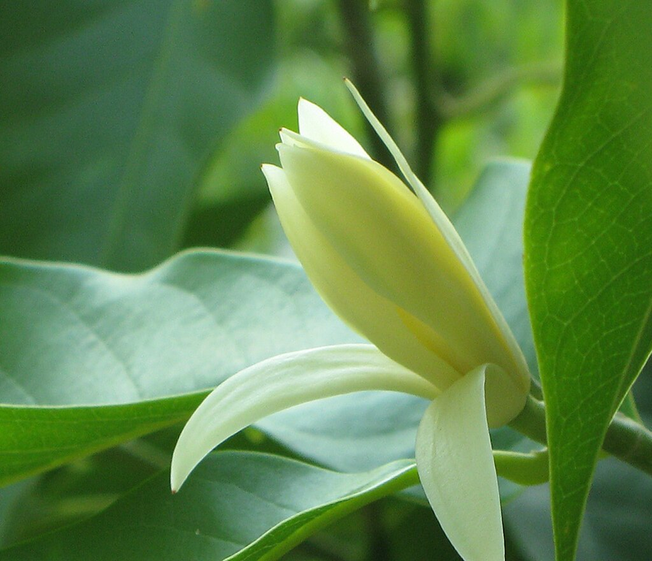
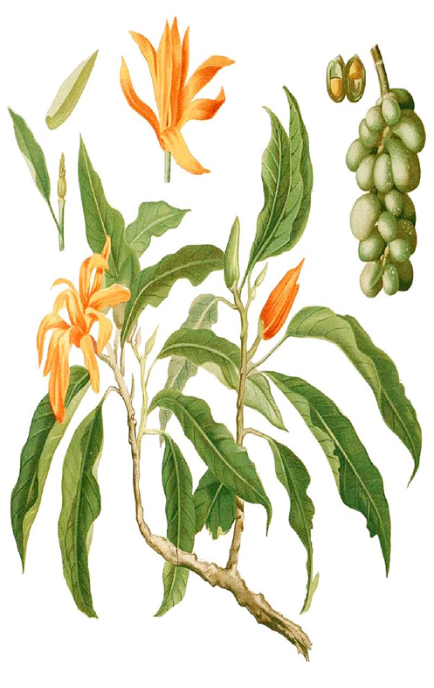
SONCHAFA
At Amphitheater - AIS campus, Wakad

Slide 2
Common Name : Sonchaafa , Yellow Champak
Scientific Name : Michelia Champaca
Family : Magnoliaceae
Habit : It is a large evergreen tree. It is known for its fragrant yellowish orange flowers. Cultivated in gardens and often found wild.
Distribution : The tree is native to the Indomalayan realm, consisting of South Asia, Southeast Asia−Indochina, and southern China.It is found in tropical and subtropical moist broadleaf forests ecoregions, at elevations of 200–1,600 metres (660–5,250 ft) .It is found in eastern Himalayas and western ghats.

Slide 3
Description :
In its native range Magnolia champaca grows to 50 metres (160 ft) or taller. Its trunk can be up to 1.9 metres (6.2 ft) in diameter. The tree has a narrow umbelliform crown.
It has strongly fragrant flowers in varying shades of cream to yellow-orange which bloom during June to September.
The obovoid-ellipsoid carpels produce 2−4 seeds during September to October.

Slide 4
USES :
Fragrance : They are primarily used in worship ceremonies, whether at home or out in temples, they are also more generally worn in hair by girls and women as a means of beauty ornament as well as a natural perfume. Flowers are floated in bowls of water to scent the room, as a fragrant and colourful decoration for bridal beds, and for garlands.
Traditionally used to make fragrant hair and massage oils.
It is a ornamental tree.Famous perfume, 'Joy', the second best selling perfume in the world is derived in part from the essential oils of champaca flowers.
It has a finely textured, dark brown and olive-colored wood, which is used in furniture making, construction.
The extract of the flowers, leaves and seeds have anti cancer, antimicrobial, antioxidant properties. Flower buds are used in treating diabetes.
Leaves act as anti-inflammatory agents, thus effective in treating swellings.
The juice of the leaves along with honey is an antidote for colic pain in infants.
The powder of the bark is used as antipyretic (reduce fever), and as a diuretic.

